Slide 1

DIGITAL PORTFOLIO
NAME: R.SHANMUGAM
REGISTER NO: 2428K0063
Naan Muthalvan id : asbrubd2428k0063
DEPARTMENT: B.Sc CS (AI&DS)
COLLEGE NAME:SHREE VENKATESHWARA ARTS AND SCIENCE COLLEGE
UNIVERSITY: BHARATHIYAR UNIVERSITY

Slide 2
My Portfolio

Slide 3
Agenda
1.Problem Statement
2.Project Overview
3.End users
4.Tools and Technologies
5.Portfolio design and Layout
6.Features anf Functionality
7.Results and Screenshot
8.Conclusion
9.GitHub Link

Slide 4
Problem Statement
I am Shanmugam and in today’s competitive world, I believe it is important to have a platform that showcases my skills, achievements, and projects effectively. A simple resume cannot fully represent my creativity, practical knowledge, and personal growth. My student portfolio is designed to present my academic background, technical expertise, and extracurricular activities in a professional way. Through this portfolio, I aim to reflect my identity and create better opportunities for internships, jobs, and higher studies.

Slide 5
Project Overview
This project is my initiative to create a personalized student portfolio that goes beyond the limitations of a traditional resume. Through it, I present my academic journey, technical skills, projects, and achievements in a creative yet professional manner. My portfolio is designed not only to highlight my strengths but also to reflect my growth, passion for continuous learning, and readiness to embrace new opportunities in academics and career.

Slide 6
End Users
The primary end users of my portfolio are recruiters, internship providers, and academic institutions who wish to understand my skills and achievements. It is also useful for mentors, teachers, and peers who want to explore my projects and growth. By creating this portfolio, I aim to provide an easy and professional way for others to view my capabilities and potential.

Slide 7
Tools and Technologies
For building my student portfolio, I used HTML, CSS, and JavaScript as the core technologies to design and develop the website. HTML helped me structure the content, CSS enhanced the design and layout, and JavaScript added interactivity to make the portfolio more dynamic. I also made use of code editors like Visual Studio Code for development and GitHub for hosting and version control.

Slide 8
Portfolio design and layout
While designing my student portfolio, I focused on creating a simple, clean, and user-friendly layout. I used a structured navigation bar to help users easily move between sections like About Me, Skills, Projects, and Contact. The design is responsive, ensuring that the portfolio looks good on both desktop and mobile devices. I chose consistent colors, fonts, and spacing to maintain a professional yet creative appearance that truly reflects my personality.

Slide 9
Features and Functionality
🔹 About Me
This section provides a brief introduction about myself, including my background, goals, and interests, helping visitors know me better.
🔹 Education
A structured timeline of my academic journey, highlighting degrees, courses, and key achievements.
🔹 Skills
A dedicated area to showcase my technical, academic, and soft skills, represented in an easy-to-read format.
🔹 Projects
This section highlights my academic and personal projects with descriptions and outcomes, giving visitors insights into my practical knowledge.

Slide 10
Features and Functionality
🔹 Certifications & Achievements
A showcase of certificates, awards, and recognitions that add value to my profile.
🔹 Contact
An interactive contact form or details that allow recruiters, mentors, and peers to connect with me directly.
🔹 Responsiveness & Interactivity
The portfolio is fully responsive for smooth access across devices and enhanced with JavaScript-based interactivity like hover effects, smooth scrolling, and dynamic navigation.

Slide 11
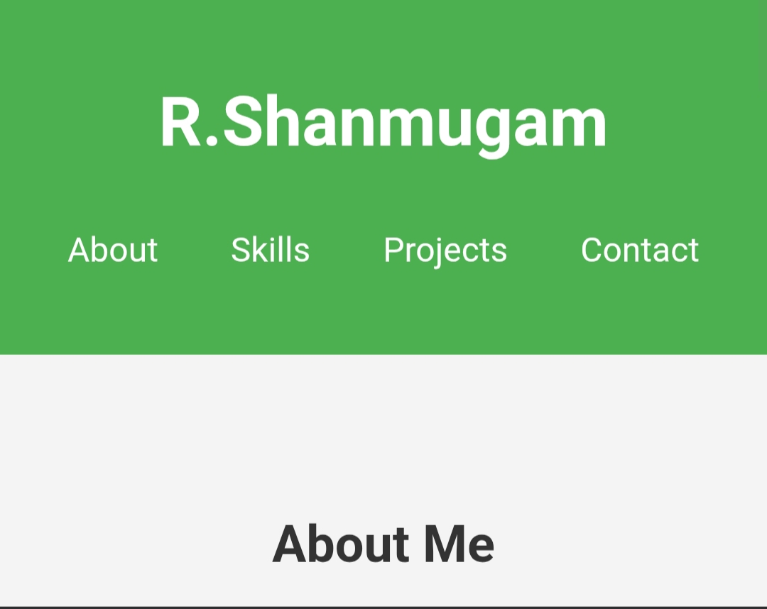
Result and Screenshot

Slide 12
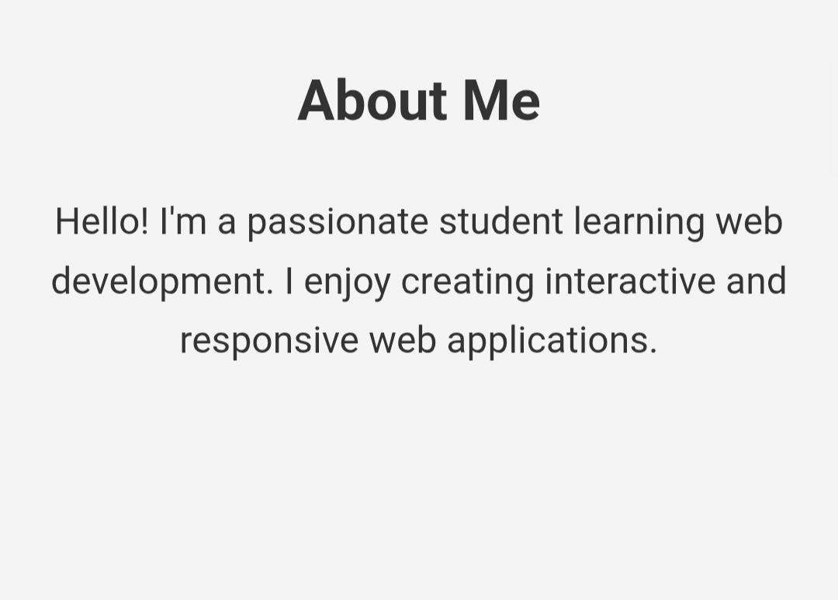
Result and Screenshot

Slide 13
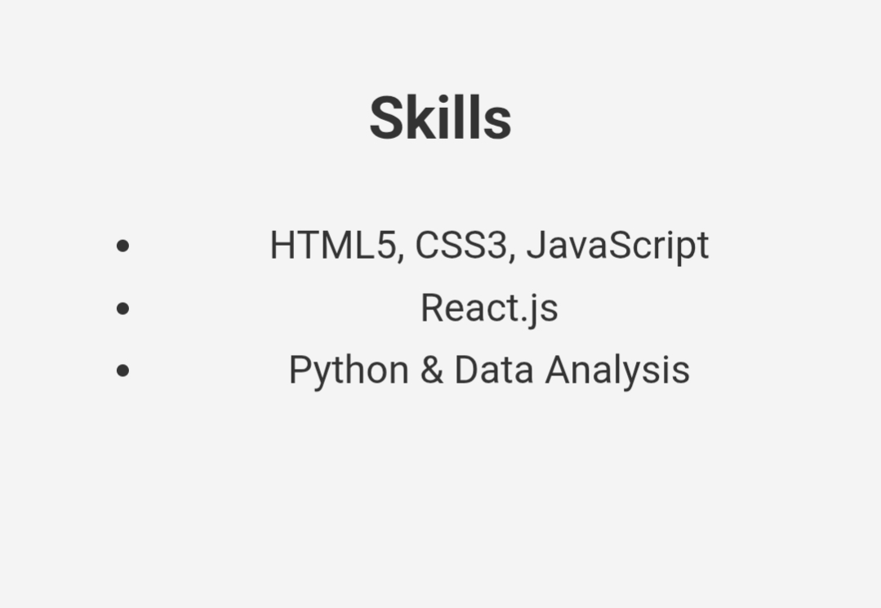
Result and Screenshot

Slide 14
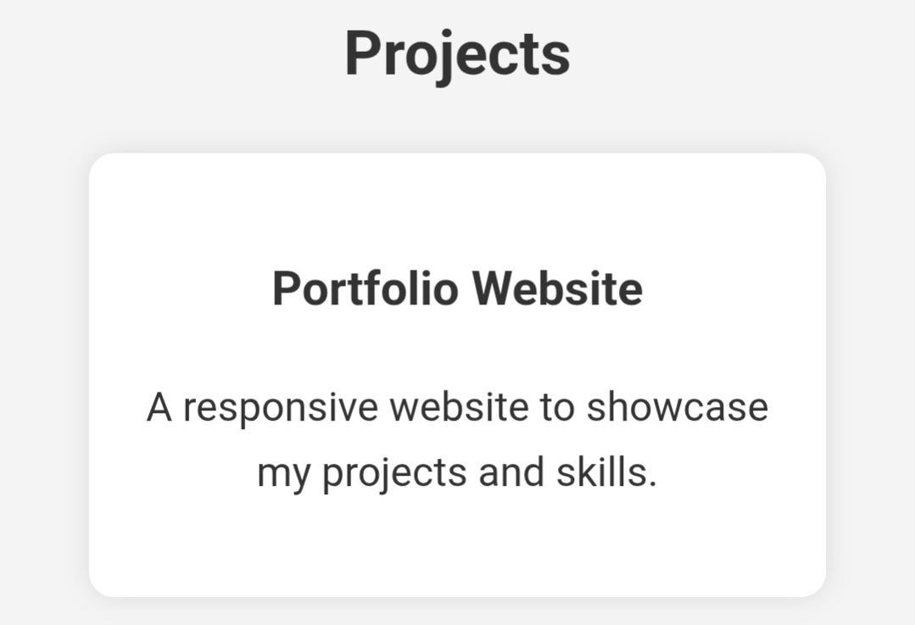
Result and Screenshot

Slide 15
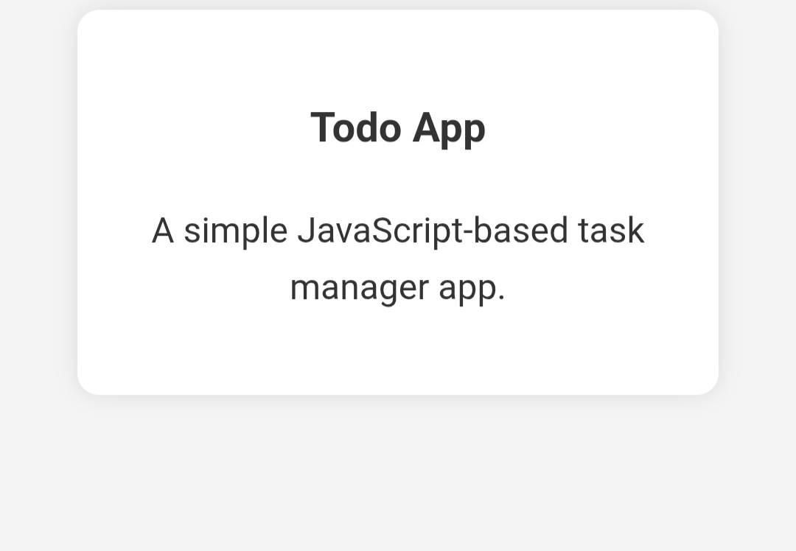
Result and Screenshot

Slide 16
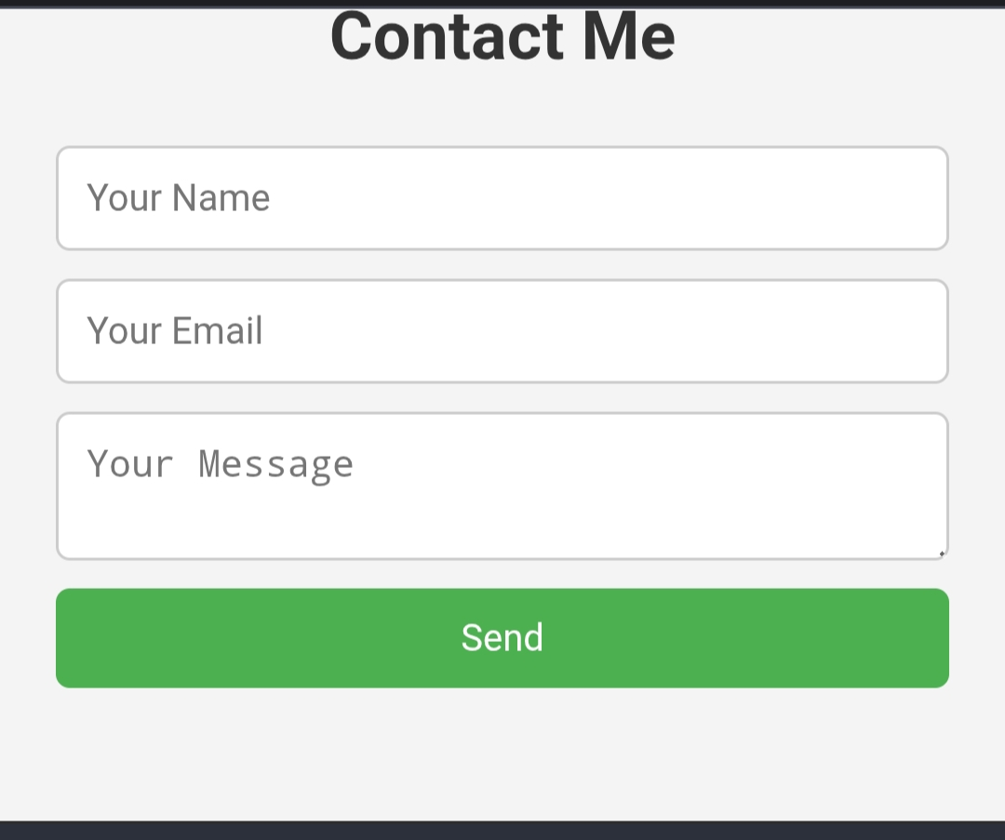
Result and Screenshot

Slide 17
Conclusion
The student portfolio website successfully demonstrates how HTML, CSS, and JavaScript can be combined to build an interactive and responsive personal portfolio. It provides a structured platform to showcase a student’s skills, projects, and achievements in a professional manner. The contact form adds interactivity and enables easy communication. This project enhances both web development knowledge and presentation skills. Overall, the portfolio serves as a creative digital resume and reflects the student’s growth and potential.

Slide 18
🔗GitHub link
https://github.com/asbrubd2428k0063/Shanmugam-.git

Slide 19
Thank You

